Slide 1
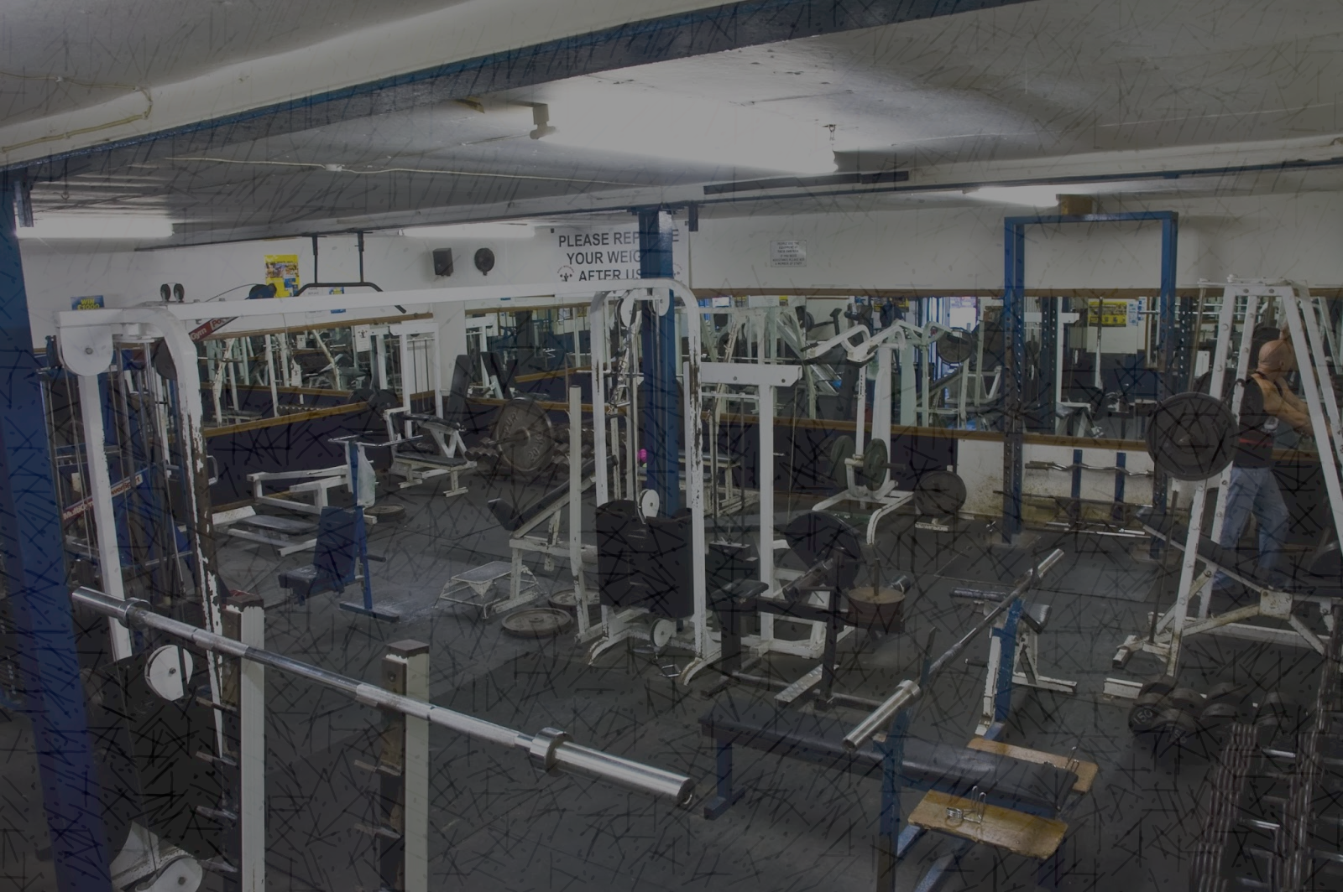
MuscleHub A/B Test
Michael Bowden
CodeAcademy Student
and
Aspiring Data Scientist

Slide 2
MuscleHub Project Overview
What is MuscleHub?
World renowed commercial fitness facility
Specializes in custom programs based on a personal fitness evaluation
Current Membership Process
Prospective members are asked to take a fitness test
Prospects then fill out an application
Payment is submitted for their first month’s membership
Issue
Management believes that the current fitness test intimidates some prospective members
A/B Test is needed to determine if the fitness test discourages membership

Slide 3
A/B Testing Overview
Conducted on visits to the facility occurring on or after 7/1/17
Visitors are grouped by:
Fitness Test
No Fitness Test
A total of 3 areas were the main focus of the testing to determine:
Who picked up an application by group
Of those picking up an application - who purchases a membership
Percent of all visitors to the facility that purchase a membership

Slide 4
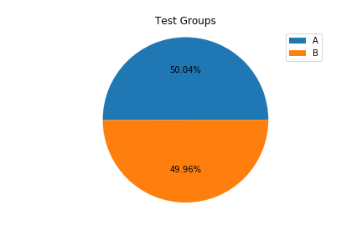
A/B Testing Groups
5004 Visitors to the facility were divided into two groups:
Group A – 2504 Visitors taking the fitness test
Group B – 2500 Visitors not taking the fitness test

Slide 5
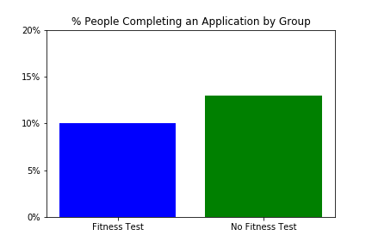
A/B Test #1: Who Picks Up an Application
Visitors picking up an application:
250 in Group A
325 in Group B
Analysis Performed:
Chi-Squared Test
Two Groups being compared
Two outcomes (Application vs No Application)
Result:
P-Value = 0.0009647827600722304
Significant difference between groups

Slide 6
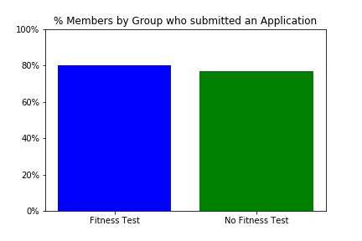
A/B Test #2: Who Purchases a Membership
Applicants purchasing a membership:
200 in Group A
250 in Group B
Analysis Performed:
Chi-Squared Test
Two Groups being compared
Two outcomes (Member vs Not Member)
Result:
P-Value = 0.43258646051083327
No significant difference between groups

Slide 7
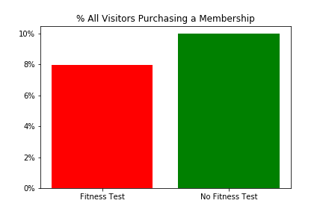
A/B Test #3: All Visitors Purchasing a Membership
Total all visitors purchasing a membership:
200 in Group A
250 in Group B
Analysis Performed:
Chi-Squared Test
Two Groups being compared
Two outcomes (Member vs Not Member)
Result:
P-Value = 0.014724114645783203
Significant difference between groups

Slide 8
A/B Testing Summary
A/B Test #1: Who Picks Up an Application:
Visitors not taking the fitness test are more likely to take an application
A/B Test #2: Who Purchases a Membership
Most visitors taking an application become members independent of the Fitness Test
A/B Test #3: All Visitors Purchasing a Membership
Visitors to the facility are more likely to purchase a membership when they don’t take the Fitness Test

Slide 9
Recommendation

